Slide 1

PIXEL ART EDITOR
A SIMPLE AND INTERACTIVE TOOL WRITTEN IN C THAT ALLOWS USERS TO DRAW AND EDIT IMAGES PIXEL BY PIXEL, WITH TOOLS FOR DRAWING, ERASING, AND FILLING COLORS.
CSE115.02 Project Update
Group-06
Team Members:
Jamil Kabir Hridoy (1931032642)
Nafis Ul Islam Nafis (2513053642)
Md. Shaiful Islam (2511965642)
Salman Farsy (2513446642)

Slide 2

SIGNIFICANCE
✅This project demonstrates core graphics programming concepts in C while providing a functional tool for artists and game developers. It’s lightweight, easy to use, and a great starting point for anyone interested in building their own digital art tools.
✅This pixel art editor lies in its educational, practical, and creative value. It provides hands-on experience with graphics programming in C using SDL2, making it a great learning tool for developers.
✅Its efficiency and simplicity make it accessible to a wide range of users, running smoothly even on low-end systems.
✅By embracing pixel art’s nostalgic charm, this editor keeps the art form alive while offering a user-friendly tool for digital creativity.

Slide 3
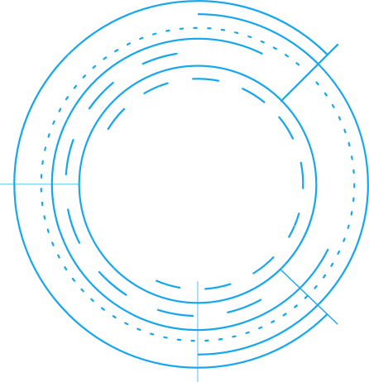
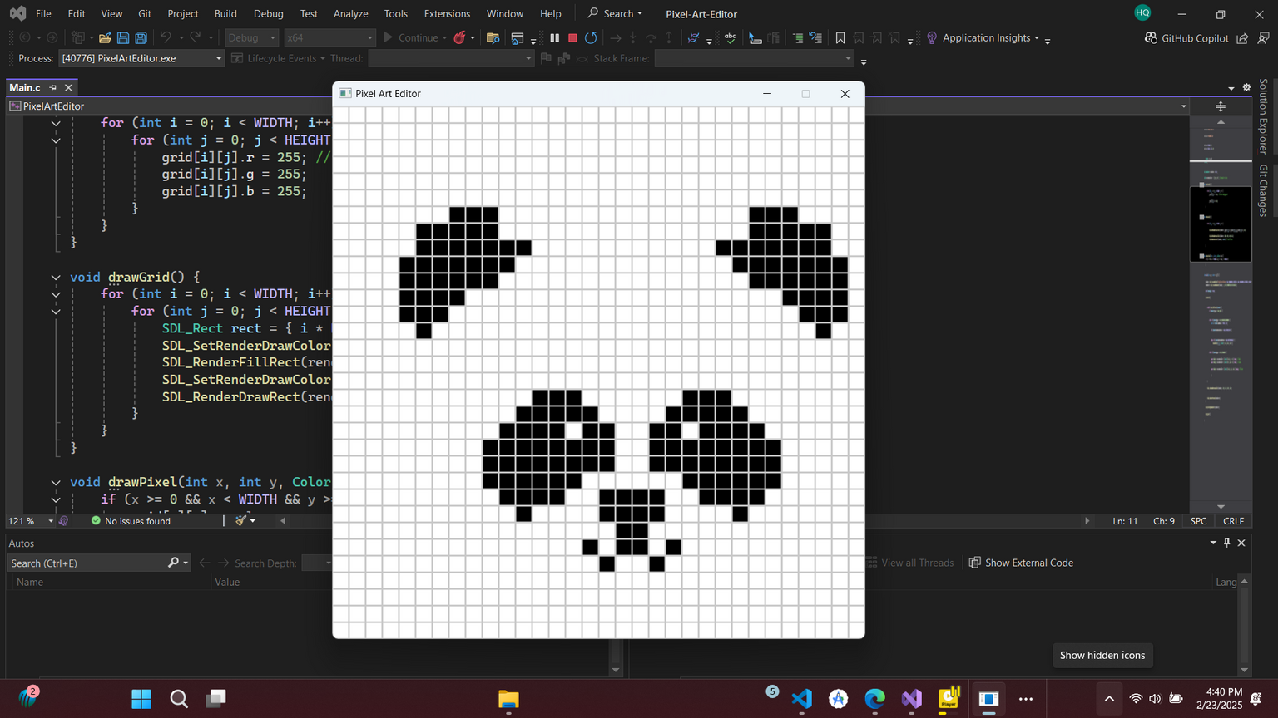
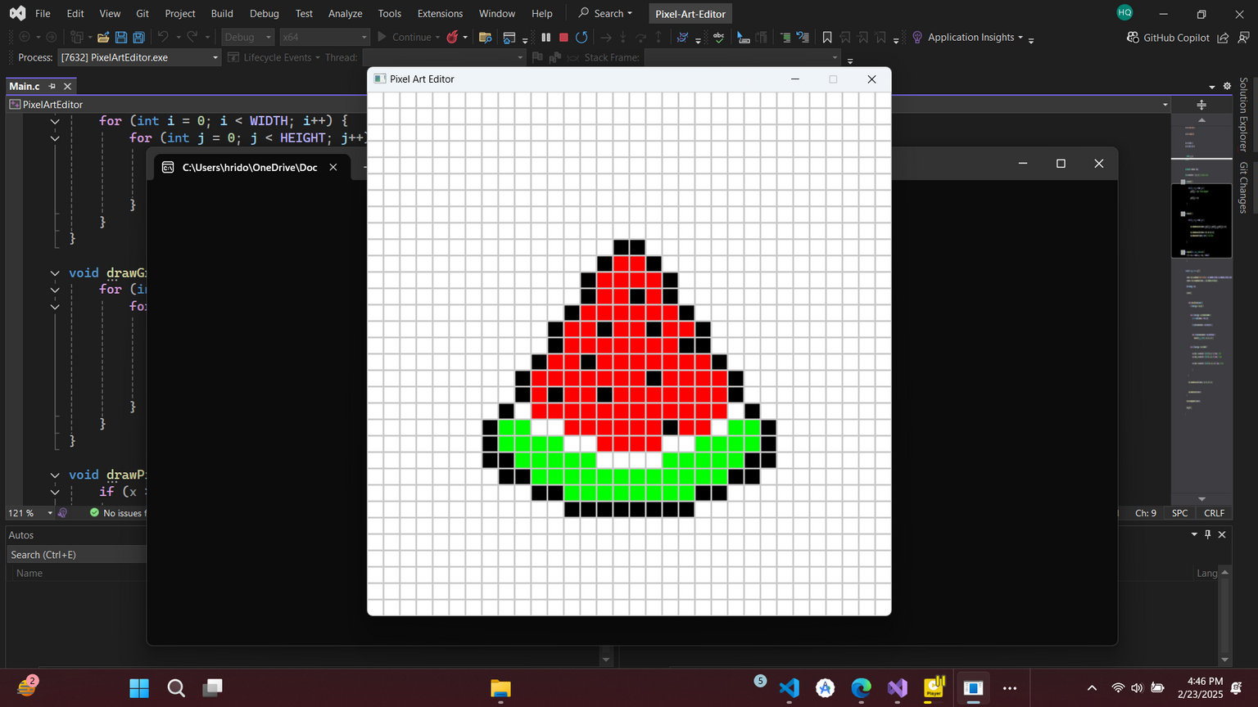

SAMPLE ARTS

Slide 4



Features Overview
32x32 pixel grid with customizable colors.
Mouse controls: Left-click to draw, right-click to erase.
R → Red
G → Green
B → Blue
W → White
K → Black
Keyboard shortcuts:
Real-time rendering with SDL2

Slide 5
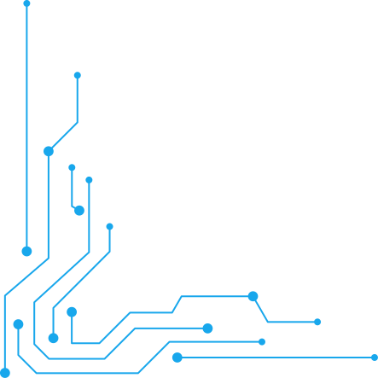
TOOLS & METHOD
1️⃣ Setup & Configuration – Installed Visual Studio 2022, configure SDL2, and link necessary libraries.
2️⃣ Application Design – Created a grid-based canvas, defined modules for input handling, rendering, and file management.
The SDL2 loop continuously listens for user inputs and updates the grid accordingly. This ensures real-time feedback for a seamless drawing experience.
3️⃣ Core Implementation:
Graphics & UI – Initialize SDL2, render grid, added a color palette.
Drawing Tools – Implement pencil, eraser, and fill bucket.
User Input – Handle mouse clicks, movements, and keyboard shortcuts.
File Handling (Future) – Support saving/loading images.
4️⃣ Testing & Debugging – Run tests, debug with Visual Studio tools, and optimized performance.
5️⃣ Finalization & Enhancements – Refining UI, add layers, animations, and export options for future upgrades. 🚀

Slide 6








FUTURE WORK
Possible Enhancements
Undo/Redo: Track pixel history using a stack.
Save/Load: Export pixel art to a bitmap (.bmp) file.
Layers & Frames: Support animation-like effects.
More Colors & UI Elements: Use buttons for better interaction.
Brush Size Options for different stroke thicknesses.

Slide 7
CONCLUSION
The pixel art editor is a simple yet effective tool for creating and editing pixel-based graphics. Built with C , it demonstrates essential graphics programming while serving as a practical tool for artists and game developers.
With features like grid-based drawing and color selection, it provides a solid foundation for future enhancements like layers and exporting. This project makes pixel art creation accessible, efficient, and enjoyable.

Slide 8

Thank You

